Slide 1
ROYAL PELICAN
Container
Storage

Slide 2
Issue #1
Some boxes placed under building in limited common space do not comply with Specifications approved on January 22, 1998.

Slide 3
Specifications
Boxes shall not exceed 34” in height, 32” in depth, and 98” in length
Boxes shall be of fiberglass or wood construction
Boxes shall be finished in white or gray to conform to bldg. colors
Boxes may be placed on blocks, total height not to exceed 42”

Slide 4
Specifications
Boxes must be anchored or tied down to prevent movement
Boxes must be kept neat, clean and securely locked
If more than one box, the total length shall not exceed width of parking space
No other structures can be placed in the under building areas

Slide 5
Resolution
Board of Directors to review and adopt new specifications, along with plan for moving forward.

Slide 6
Challenge
Consensus by Community and Board.

Slide 7
Issue #2
Boxes have been placed in common space (not under buildings) and violate Rules & Regulations #3 – No items are to be left in corridors, stairways, elevators or common space.

Slide 8
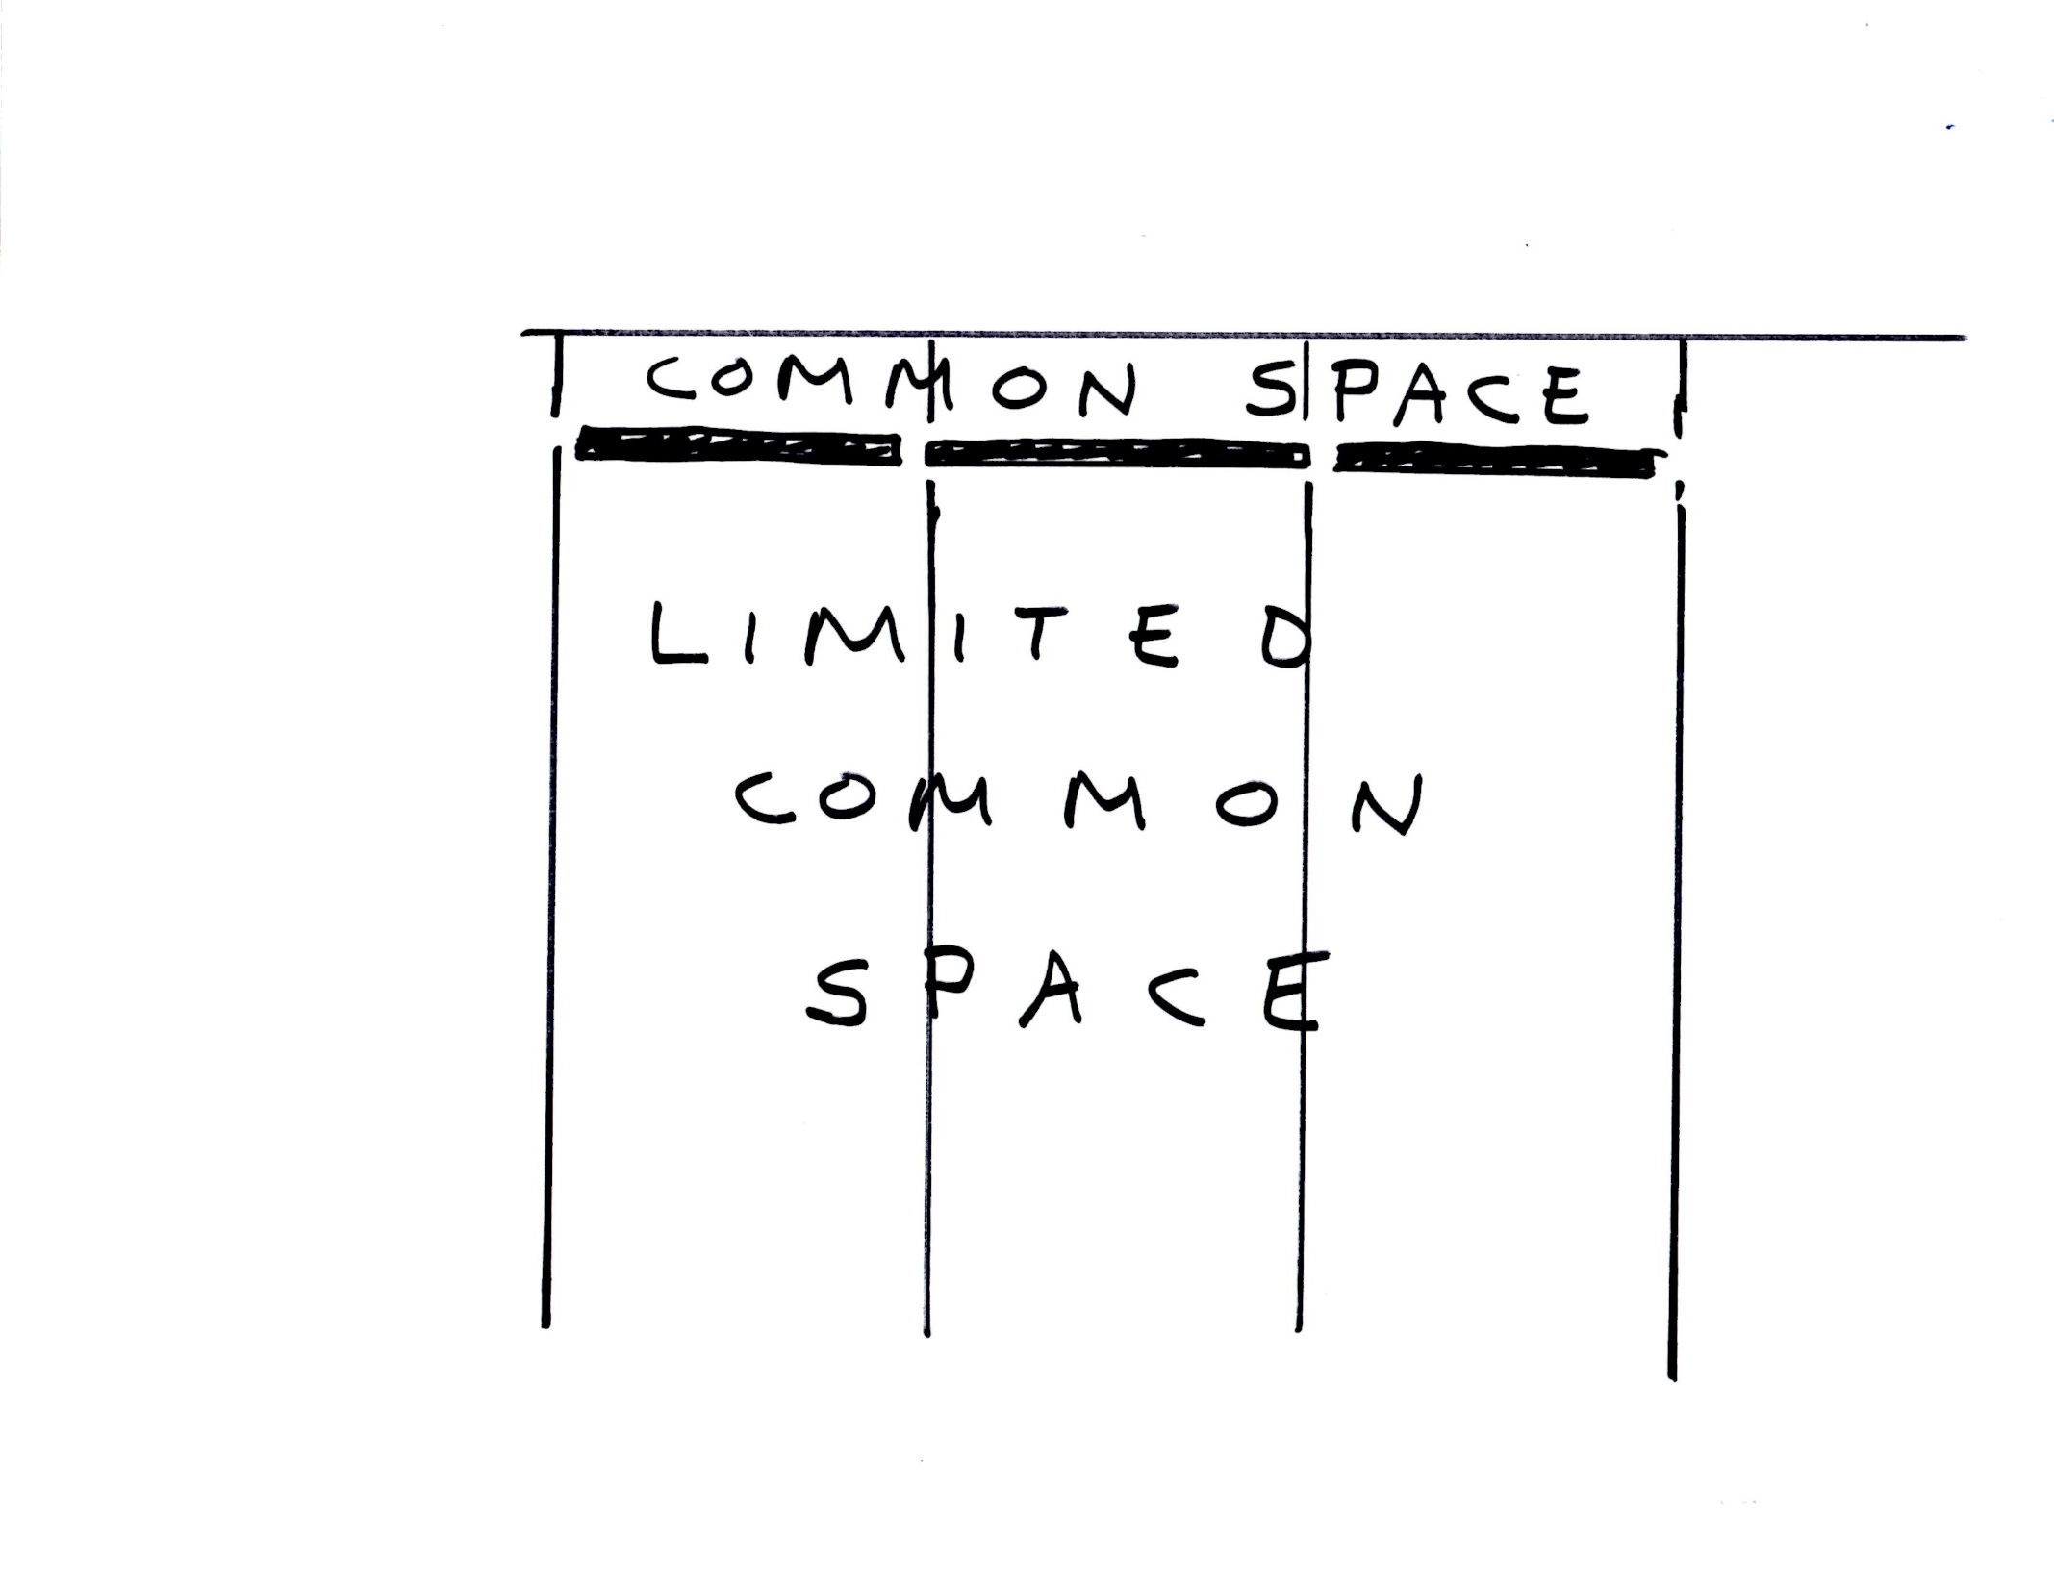

Slide 9
Resolution
1. Amend Rules & Regulations to define the entire assigned parking space, including any paved areas beyond the parking stop as limited common space. Board of Directors can then adopt specifications for these storage boxes.
OR
2. Remove existing boxes from these locations.

Slide 10
Amendment
6.5.2.1. Parking space or spaces assigned to the unit. Each unit shall have assigned to it by the Developer a minimum of one (1) parking space as a limited common element appurtenant thereto. The limited common element parking space(s) assigned to a unit shall extend to the entirety of the paved areas of the parking space, including any paved area beyond the parking stop. Such areas are reserved to the exclusive use of the unit owner, including for the installation of storage lockers, if there is space for same. The Association, through the Board of Directors, shall have the authority to adopt reasonable rules and regulations regarding the use of the limited common area parking spaces, including the installation of storage lockers.

Slide 11
Challenges
An amendment must be approved by two-thirds of the voting interests of the Association present (in person or by proxy) and at a duly noticed meeting at which a quorum is present.

