Slide 1
Landscape committee recommendations
Betts Bonito Lou Dickman Lee Garner Russ Mell Ray Waldmann

Slide 2
Everyday Maintenance professional landscape design at no charge
Cost prohibitive to complete in one year within our budget
Three-year plan

Slide 3
All east-facing buildings –one design using plants for eastern exposure
All west-facing buildings—one design using plants for western exposure
Remove and replace all plants in target/phase 1 area

Slide 4
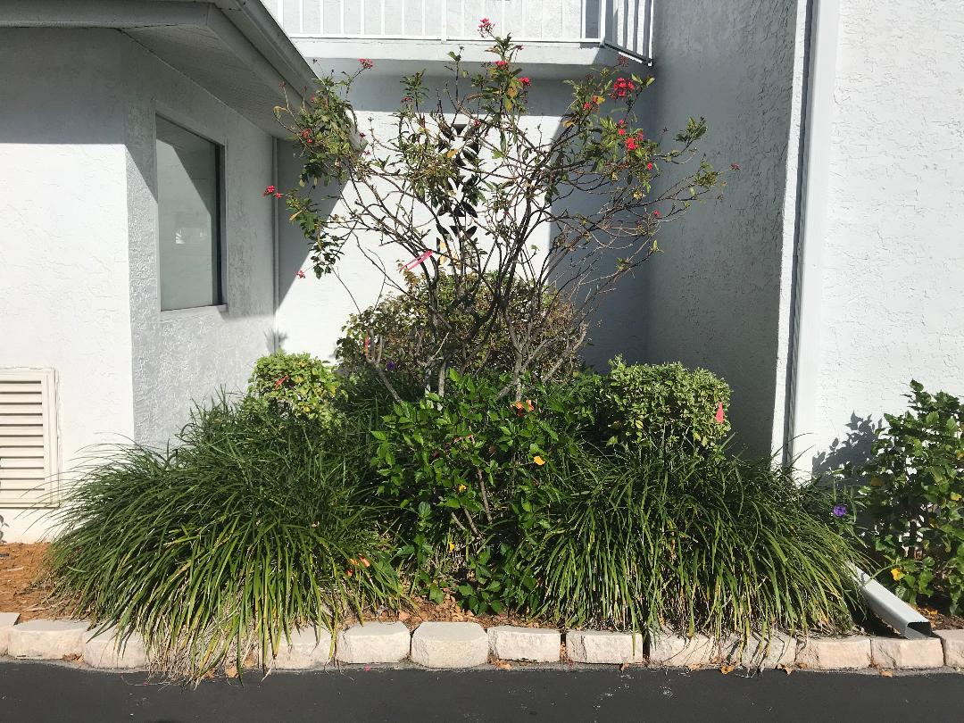
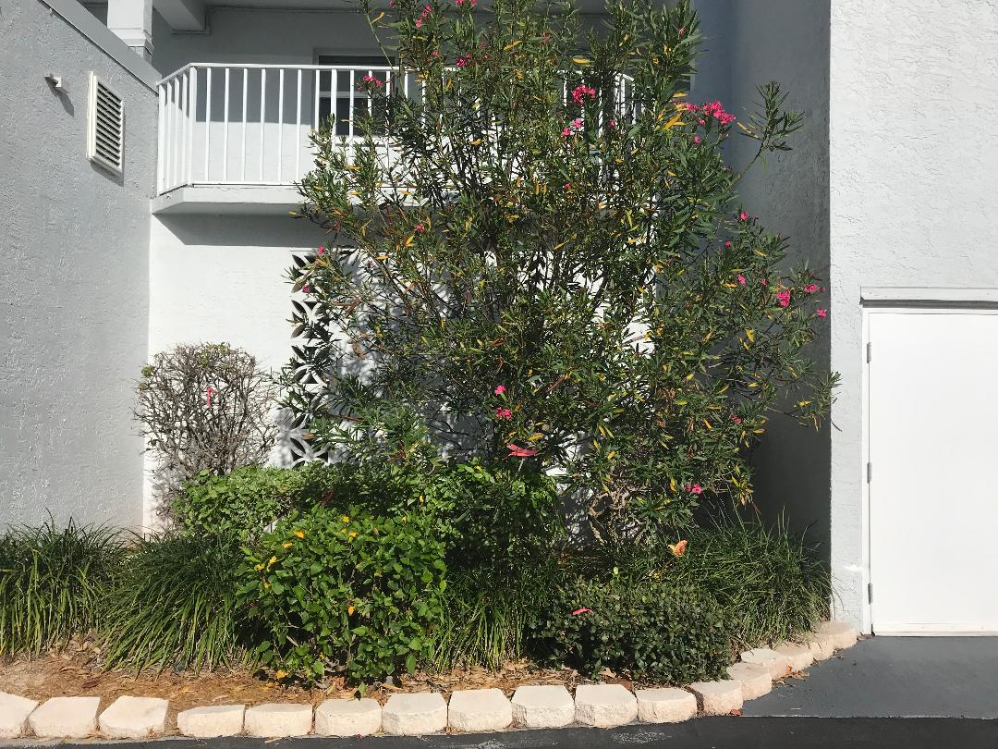
PHASE 1: Both building insets – small--right of lobby large--left of trash room

Slide 5
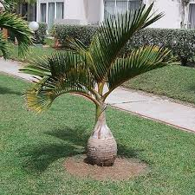
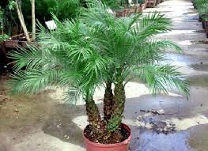
All buildings:
Small inset: Bottle Palm
Large inset: Dwarf Pygmy Date Palm

Slide 6
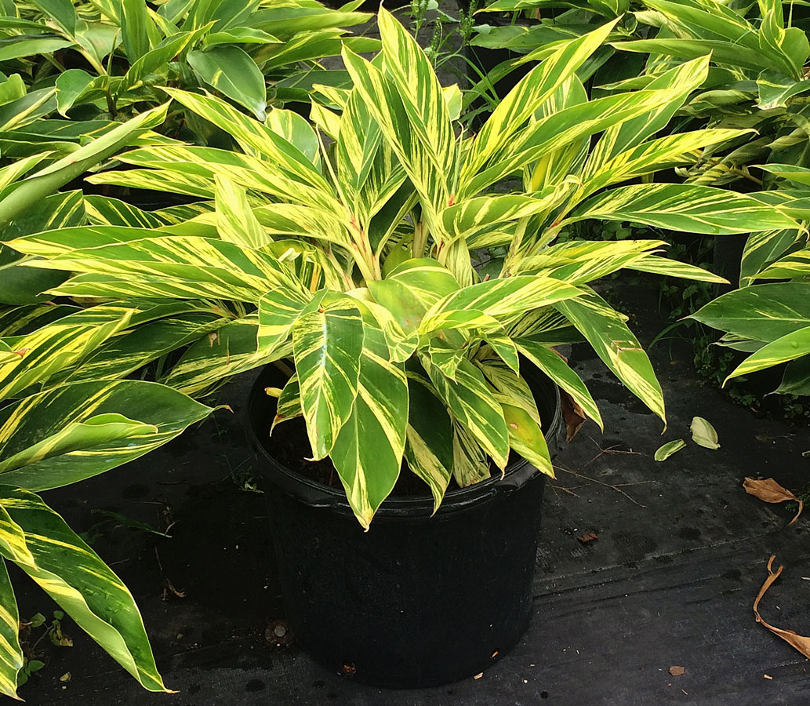
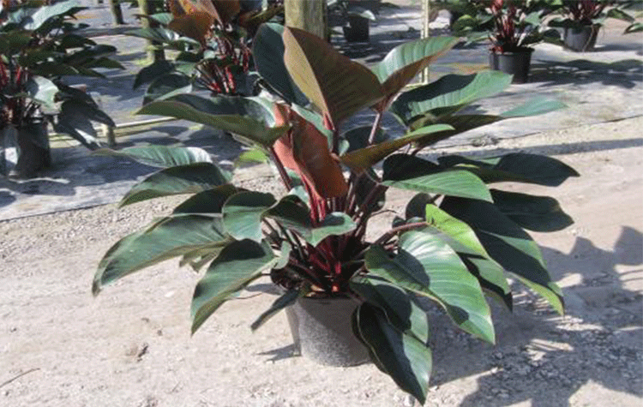
EAST-FACING BUILDINGS –both insets
Red Congo
Variegated Ginger

Slide 7
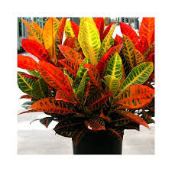
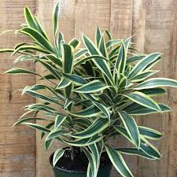
WEST-FACING BUILDINGS – both insets
Petra Croton
Song of India

Slide 8
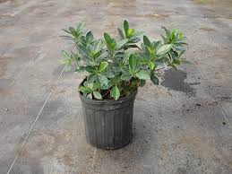
FRONT OF BOTH BEDS– ALL BUILDINGS
Green Island Ficus

Slide 9
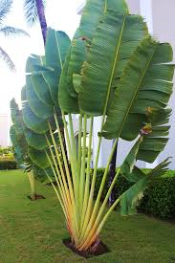
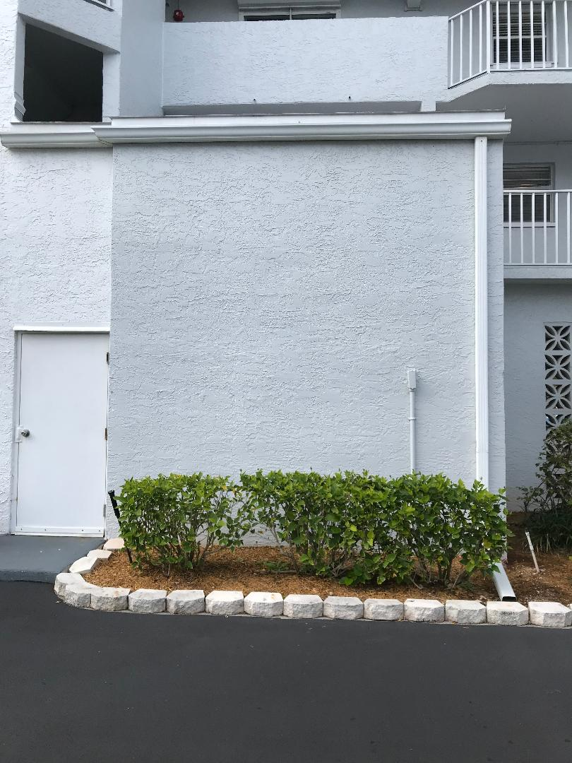
Both large plain walls on each building next to stairwell doors
Traveler Palm

Slide 10
Irrigation evaluation:
Confidence in system to support new plantings?
Some “tune-up” work must be done
Height and location of some sprinkler heads
Broken pipes at sprinkler heads

Slide 11
Phase 1 costs:
Remove existing plants $1945
New plantings installed $8991
Total $10936

Slide 12
Irrigation fix:
Request board to approve $2500 for minimum irrigation work to support new plantings and overall property benefit

