Slide 1
RP 2021 Goals & TBD
Part of Directors’ Reports

Slide 2
Overarching Goals & TTD List
Property Management RFP/Selection (2/17 mtg)
Comcast Contract Restructure
Budget
Building Reps
Website Update
Activities
EBIA Recreational Facilities
Buildings & Grounds (see next 2 slides)

Slide 3
Buildings & Grounds
Pool repairs
Block/mulch removal in front of bldgs
Remaining new benches
Parking lot bumpers
Parking lot resurfacing
Walkway resurfacing (multi-year)

Slide 4
Buildings & Grounds (cont.)
LTE upgrade for fire alarms
Elevator pit repairs – bldgs. 2 & 3
Pressure wash roofs
Trash and Recycling – new times
Trash pickup at 11am Tuesday and recycle pickup at 12pm Thursday
Containers now will be put out for trash at 9am and recycle at 10am

Slide 5
Ray’s Parting Words…
Never answer an anonymous letter
You’ve got to be very careful if you don’t where you are going because you might not get there
I never said most of the things I said
If the world was perfect it wouldn’t be
When you come to the fork in the road take it

Slide 6
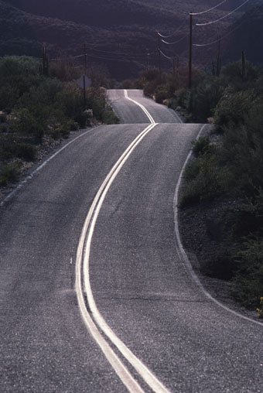
RAY & BOB
Thank You & Good Luck!

